Slide 1
Dependency Injection
Module 16

Slide 2
Content
IoC & Dependency Injection
Constructor vs setter injection
Injecting collections

Slide 3
IoC & Dependency Injection
Inversion of Control
Principle where the control flow of the program in inverted
E.g. a library or a framework (like Spring IoC container) takes care about to pass implementations to the classes using them
Create instances of dependencies first and later instance of the class using these dependencies
Inversion of the way of how the instances of dependencies are being injected into the class using them
Dependency Injection
Concrete implementation (pattern) of IoC
Injecting objects (dependencies) into the classes required them via constructors or setters

Slide 4
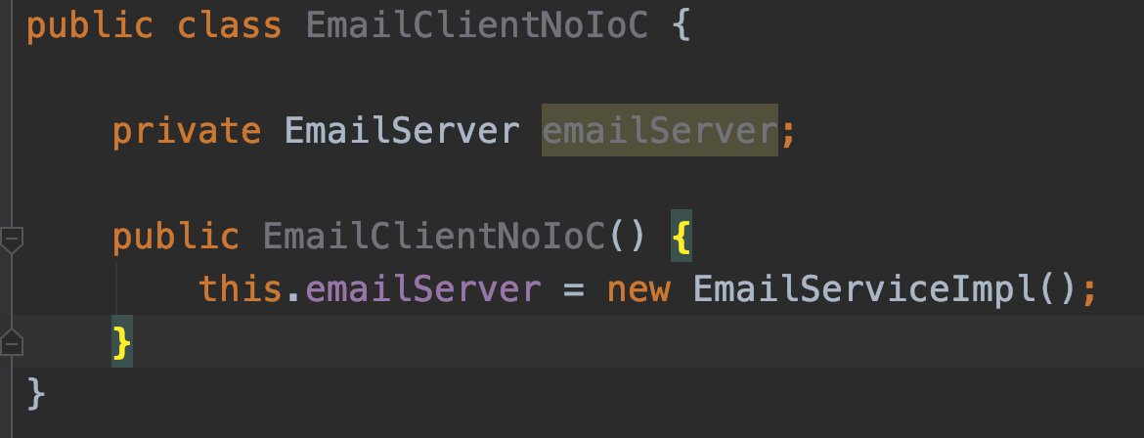
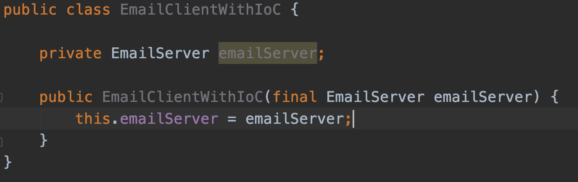
IoC & Dependency Injection
No IoC
Yes IoC

Slide 5
Constructor vs setter injection
Constructor based injection
Beans dependency is set when the constructor is called
Setter based injection
Beans dependency is set when the setter is called

Slide 6
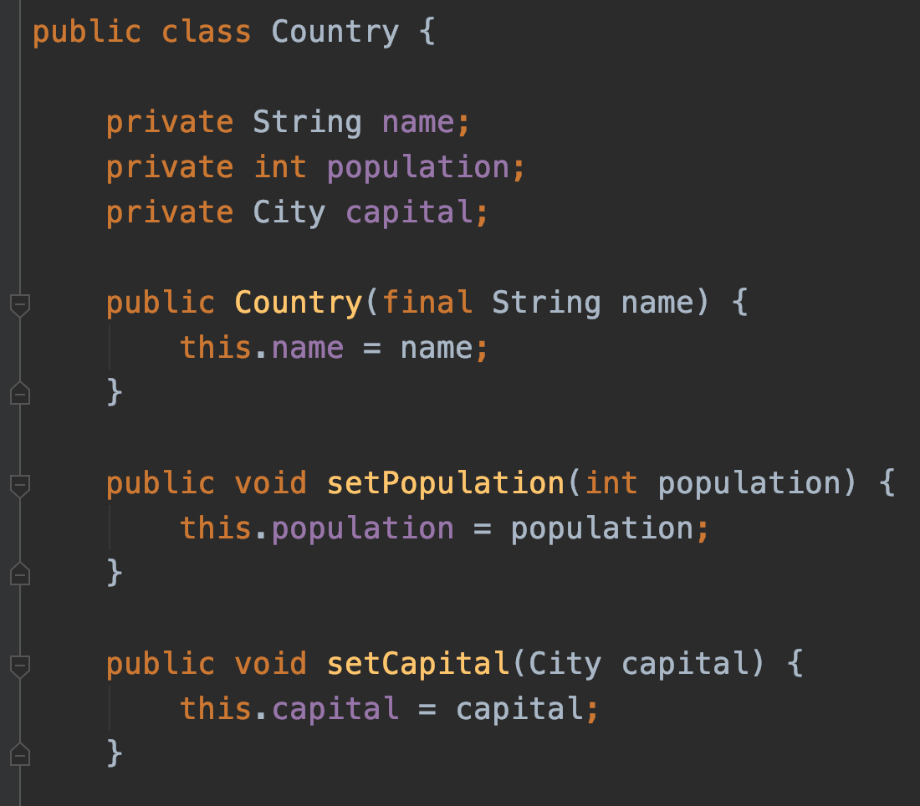
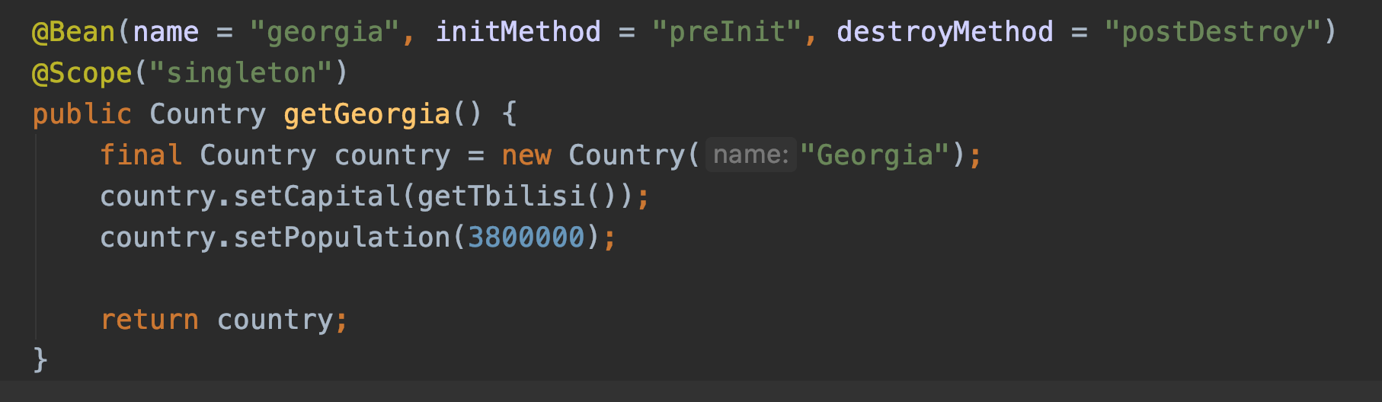
Constructor vs setter injection

Slide 7
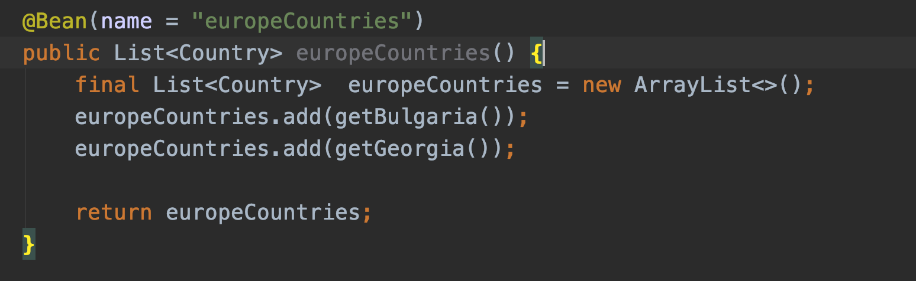
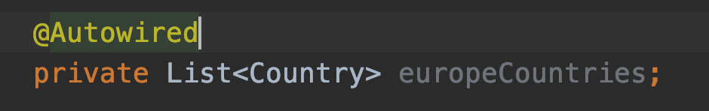
Injecting collections
Defining of a collection in Java Based configuration is same way as you are defining any other bean
Example:
Autowireing:

Slide 8
Demo

Slide 9
Questions?
Notes:
Do you have any questions?

Slide 10
Thank You For Your Time

